Slide 1
Opções com Barreira (Reiner & Rubinstein -1991)
Gustavo M. de Athayde

Slide 2
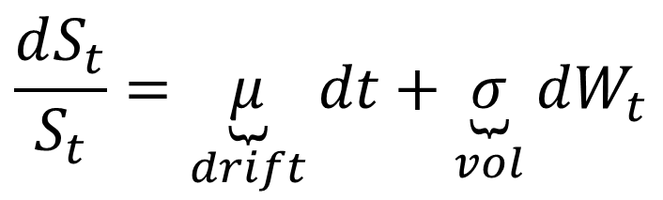
Opções com Barreira
Path-dependent
Knock –In / Knock-Out
Up / Down
Ativo tem a seguinte dinâmica:
$$\frac{dS_{t}}{S_{t}}=\underset{drift}{\underbrace{μ}}dt+\underset{vol}{\underbrace{σ}}dW_{t}$$

Slide 3
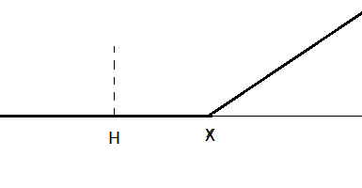
Call Down & In
Barreira (H) < Strike (X)

Slide 4
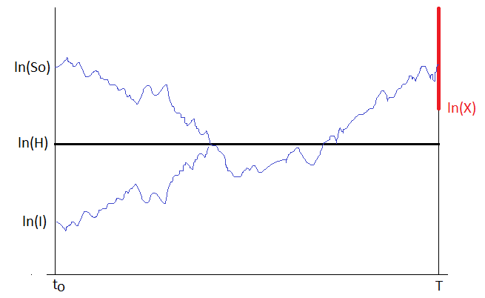
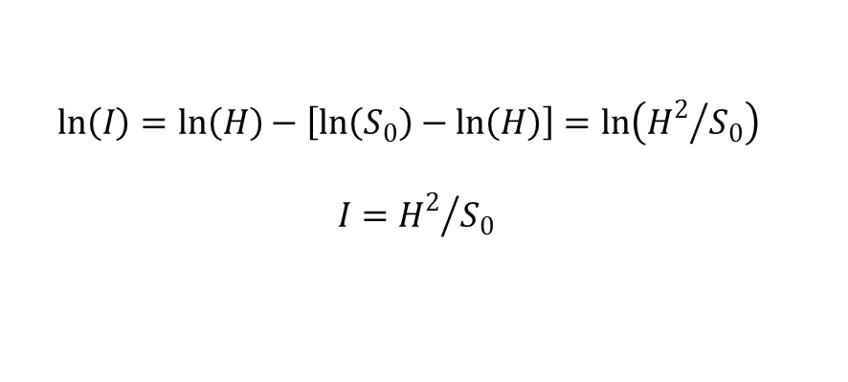
O Princípio da Reflexão (μ=0)
$$\ln\left(I\right)=\ln\left(H\right)−\left[\ln\left(S_{0}\right)−\ln\left(H\right)\right]=\ln\left({H^{2}}/{S_{0}}\right)$$
$$I={H^{2}}/{S_{0}}$$

Slide 5
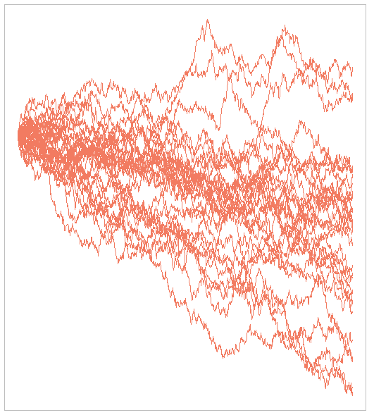
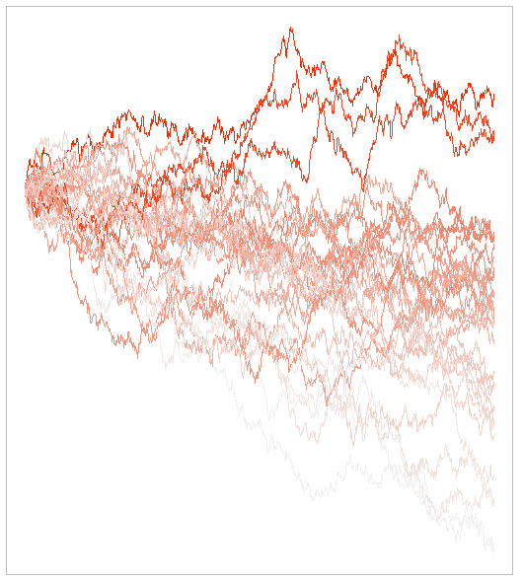
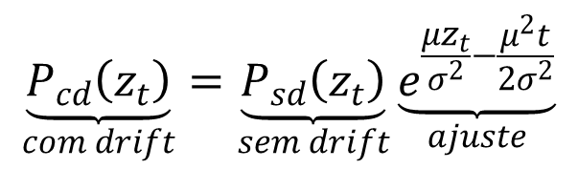


A Fórmula de Girsanov
$$μ<0$$
$$μ=0$$
$$\underset{com drift}{\underbrace{P_{cd}\left(z_{t}\right)}}=\underset{sem drift}{\underbrace{P_{sd}\left(z_{t}\right)}}\underset{ajuste}{\underbrace{e^{\frac{μz_{t}}{σ^{2}}−\frac{μ^{2}t}{2σ^{2}}}}}$$

Slide 6
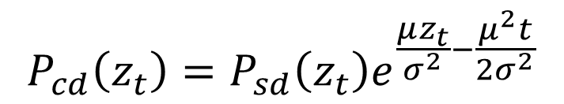
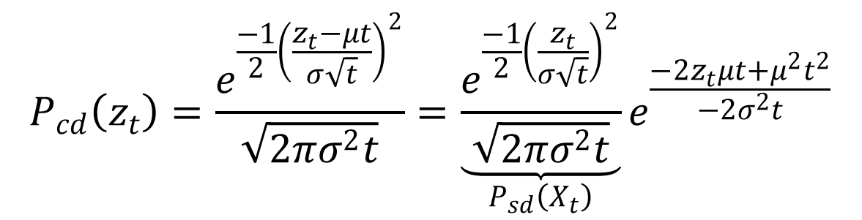
A Fórmula de Girsanov
$$P_{cd}\left(z_{t}\right)=\frac{e^{\frac{−1}{2}{\left(\frac{z_{t}−μt}{σ\sqrt{t}}\right)}^{2}}}{\sqrt{2πσ^{2}t}}=\underset{P_{sd}\left(X_{t}\right)}{\underbrace{\frac{e^{\frac{−1}{2}{\left(\frac{z_{t}}{σ\sqrt{t}}\right)}^{2}}}{\sqrt{2πσ^{2}t}}}}e^{\frac{−2z_{t}μt+μ^{2}t^{2}}{−2σ^{2}t}}$$
$$P_{cd}\left(z_{t}\right)=P_{sd}\left(z_{t}\right)e^{\frac{μz_{t}}{σ^{2}}−\frac{μ^{2}t}{2σ^{2}}}$$

Slide 7
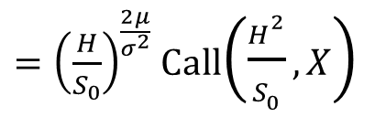
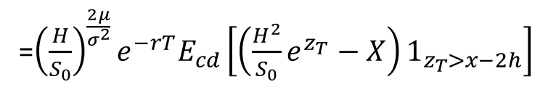
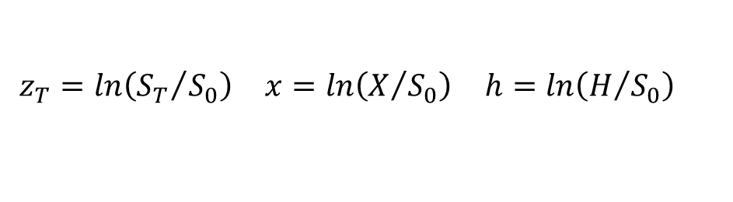
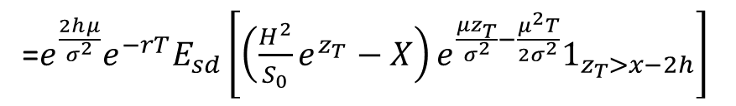
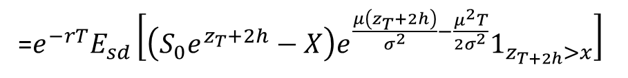
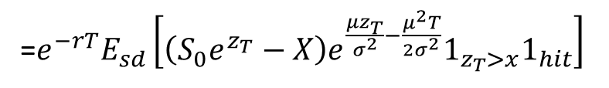
Apreçamento com Drift
$$\begin{matrix}z_{T}=ln\left({S_{T}}/{S_{0}}\right) & x=ln\left(X/{S_{0}}\right) & h=ln\left(H/{S_{0}}\right)\end{matrix}$$
CDI$\left(S_{0},X,H\right)={e_{}^{−rT}E}_{cd}\left[{\left(S_{0}e_{}^{z_{T}}−X\right)1}_{z_{T}>x}1_{hit}\right]$
=${e_{}^{−rT}E}_{sd}\left[{\left(S_{0}e_{}^{z_{T}}−X\right)e^{\frac{μz_{T}}{σ^{2}}−\frac{μ^{2}T}{2σ^{2}}}1}_{z_{T}>x}1_{hit}\right]$
=${e_{}^{−rT}E}_{sd}\left[{\left(S_{0}e_{}^{z_{T}+2h}−X\right)e^{\frac{μ\left(z_{T}+2h\right)}{σ^{2}}−\frac{μ^{2}T}{2σ^{2}}}1}_{z_{T+2h}>x}\right]$
=${e^{\frac{2hμ}{σ^{2}}}e^{−rT}E}_{sd}\left[{\left(\frac{H^{2}}{S_{0}}e_{}^{z_{T}}−X\right)e^{\frac{μz_{T}}{σ^{2}}−\frac{μ^{2}T}{2σ^{2}}}1}_{z_{T}>x−2h}\right]$
=${{\left(\frac{H}{S_{0}}\right)}^{\frac{2μ}{σ^{2}}}e^{−rT}E}_{cd}\left[{\left(\frac{H^{2}}{S_{0}}e_{}^{z_{T}}−X\right)1}_{z_{T}>x−2h}\right]$
${=\left(\frac{H}{S_{0}}\right)}^{\frac{2μ}{σ^{2}}}$Call$\left(\frac{H^{2}}{S_{0}},X\right)$

Slide 8
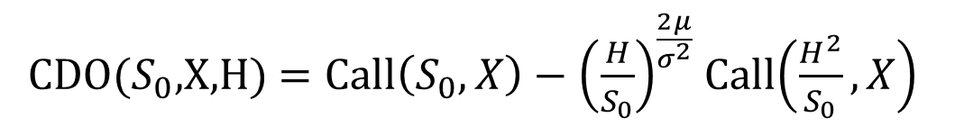
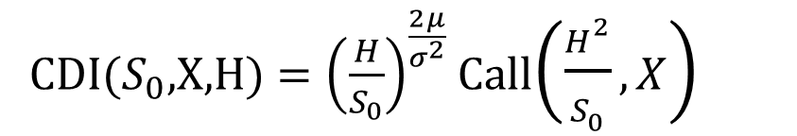
Call Down (H<X)
CDI($S_{0}$,X,H) ${=\left(\frac{H}{S_{0}}\right)}^{\frac{2μ}{σ^{2}}}$Call$\left(\frac{H^{2}}{S_{0}},X\right)$
CDO($S_{0}$,X,H) ${=\text{Call}\left(S_{0},X\right)−\left(\frac{H}{S_{0}}\right)}^{\frac{2μ}{σ^{2}}}$Call$\left(\frac{H^{2}}{S_{0}},X\right)$

Slide 9
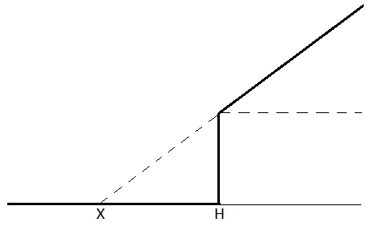
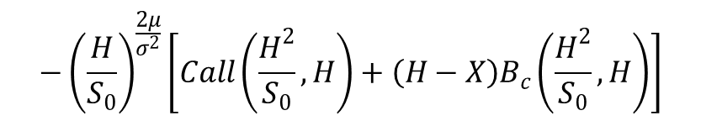
Call Down (H>X)
$$CDO\left(S_{0},X,H\right)=Call\left(S_{0},H\right)+\left(H−X\right)B_{c}\left(S_{0},H\right)$$
$$−{\left(\frac{H}{S_{0}}\right)}^{\frac{2μ}{σ^{2}}}\left[Call\left(\frac{H^{2}}{S_{0}},H\right)+\left(H−X\right)B_{c}\left(\frac{H^{2}}{S_{0}},H\right)\right]$$
$$CDI\left(S_{0},X,H\right)=Call\left(S_{0},X\right)−CDO\left(S_{0},X,H\right)$$

Slide 10
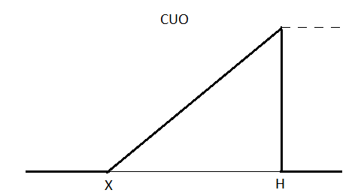
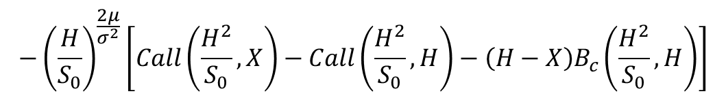
Call UP (H>X)
$$CUO\left(S_{0},X,H\right)=Call\left(S_{0},X\right)−Call\left(S_{0},H\right)−\left(H−X\right)B_{c}\left(S_{0},H\right)$$
$$−{\left(\frac{H}{S_{0}}\right)}^{\frac{2μ}{σ^{2}}}\left[Call\left(\frac{H^{2}}{S_{0}},X\right)−Call\left(\frac{H^{2}}{S_{0}},H\right)−\left(H−X\right)B_{c}\left(\frac{H^{2}}{S_{0}},H\right)\right]$$
$$CUI\left(S_{0},X,H\right)=Call\left(S_{0},X\right)−CDO\left(S_{0},X,H\right)$$

Slide 11
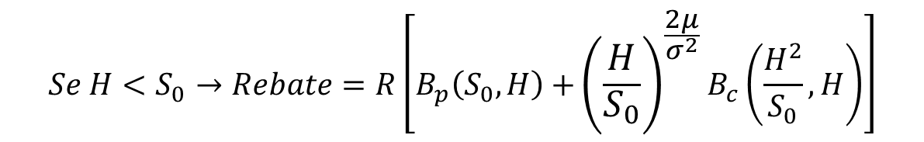
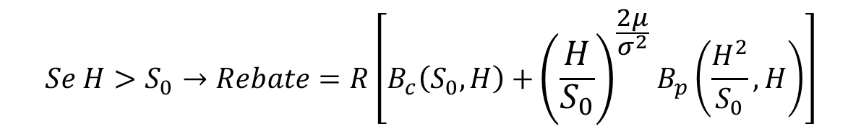
Rebates no Vencimento
. Suponha que se a barreira for cruzada em algum momento, paga-se um valor R no vencimento da opção.
$$Se H>S_{0}→Rebate=R\left[B_{c}\left(S_{0},H\right)\text{ +}{\left(\frac{H}{S_{0}}\right)}^{\frac{2μ}{σ^{2}}}B_{p}\left(\frac{H^{2}}{S_{0}},H\right)\right]$$
$$Se H<S_{0}→Rebate=R\left[B_{p}\left(S_{0},H\right)\text{ +}{\left(\frac{H}{S_{0}}\right)}^{\frac{2μ}{σ^{2}}}B_{c}\left(\frac{H^{2}}{S_{0}},H\right)\right]$$

Slide 12
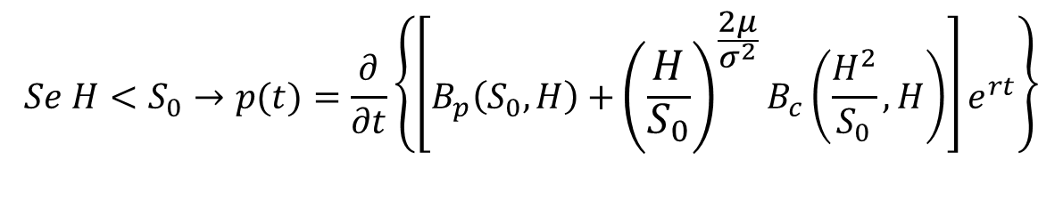
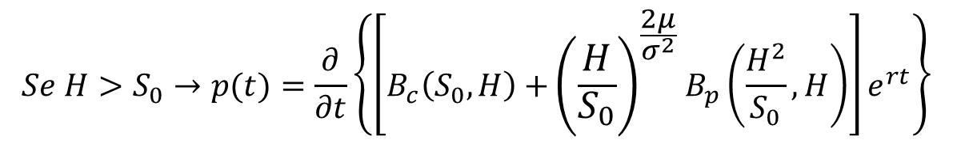
Rebates at hit
. A probabilidade do primeiro toque da barreira ocorrer num momento t, denotada por p(t) é dado por:
$$Se H>S_{0}→p(t)=\frac{∂}{∂t}\left\{\left[B_{c}\left(S_{0},H\right)\text{ +}{\left(\frac{H}{S_{0}}\right)}^{\frac{2μ}{σ^{2}}}B_{p}\left(\frac{H^{2}}{S_{0}},H\right)\right]e^{rt}\right\}$$
$$Se H<S_{0}→p(t)=\frac{∂}{∂t}\left\{\left[B_{p}\left(S_{0},H\right)\text{ +}{\left(\frac{H}{S_{0}}\right)}^{\frac{2μ}{σ^{2}}}B_{c}\left(\frac{H^{2}}{S_{0}},H\right)\right]e^{rt}\right\}$$

Slide 13

Rebates at hit
. Logo a fórmula do rebate-at-hit (rah) será dada por:
$$rah=\int_{0}^{T}{e^{−rt}p\left(t\right)}dt$$

